Slide 1
FSM Project Group 4
Joshuan Jimenez
Albert De Armas
Even Taieb
Shadman Noor

Slide 2
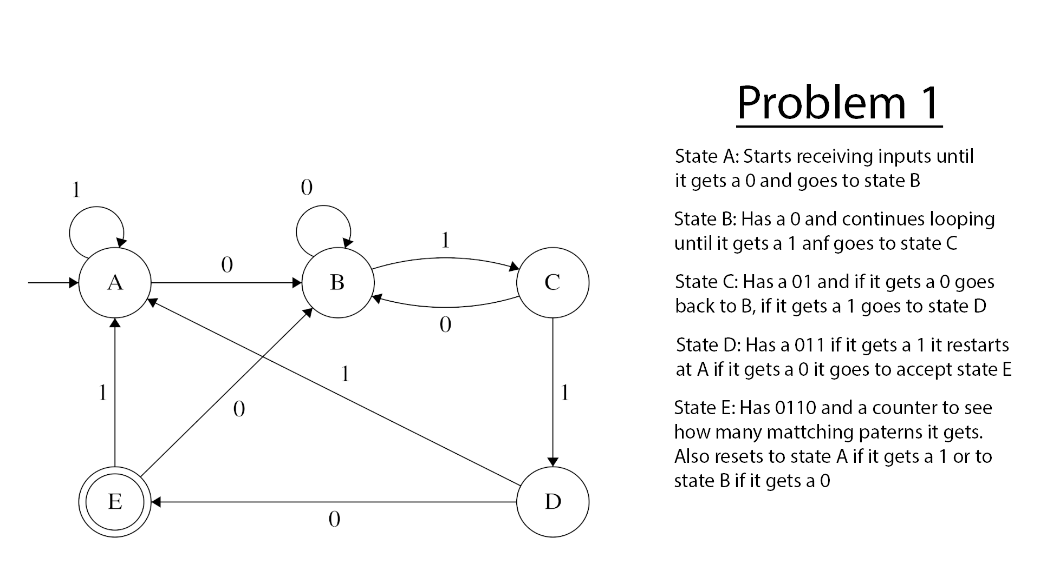

Slide 3








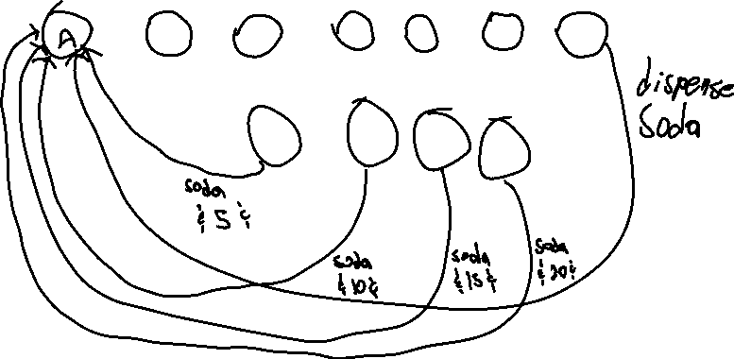
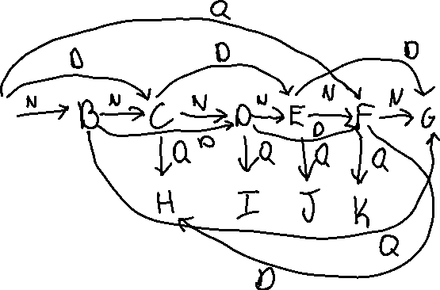

Problem 2 Diagram

Slide 4
States
States are 0, 5, 10, 15, 20, 25, 30, 35, 40, 45, and 50.
A = 0, B = 5, C= 10, D = 15… J = 45, and K = 50.
States represent total amount deposited.
Final states are 30, 35, 40, 45, and 50, since they dispense a soda and/or change.

Slide 5
Variables
The amount being put into the machine.
Adds money to the machine and changes the state.
If counter reaches 30 or more, the machine will dispense a soda and whatever excess change there is.

Slide 6
Transition Vectors
Putting in a nickel (N), dime (D), or quarter (Q).
Putting in a nickel adds 5 cents to the counter.
Putting in a dime adds 10 cents to the counter.
Putting in a quarter adds 25 cents to the counter.

